Slide 1
Running Jobs on the Open Science Grid
Brian Lin
OSG Software Team
University of Wisconsin–Madison

Slide 2
Local High Throughput Computing
resources
local
UW–Madison
compute

Slide 3
Local High Throughput Computing
resources
local
UW–Madison
compute

Slide 4
How do you get more computing resources?

Slide 5
#1: Buy Hardware
Great for specific hardware/privacy requirements
Costs $$$
Initial cost
Maintenance
Management
Power and cooling
Rack/floor space
Obsolescence
Plan for peak usage, pay for all usage
Delivery and installation takes time

Slide 6
#2: Use the Cloud - Pay per cycle
Amazon Web Services, Google Compute Engine, Microsoft Azure, etc.
Fast start-up
Costs $$$
Still needs expertise + management
Easier than in the past with the condor_annex tool
Does payment fit with your institutional or grant policies?

Slide 7
#2: Use the Cloud - ‘Managed’ clouds
Cycle Computing, Globus Genomics
Pay someone to manage your cloud resources — still costs $$$
Researchers and industry have used this to great success
Using Docker, HTCondor, and AWS for EDA Model Development
Optimizations in running large-scale Genomics workloads in Globus Genomics using HTCondor
HTCondor in the enterprise
HTCondor at Cycle Computing: Better Answers. Faster.

Slide 8
#3: Distributed High Throughput Computing (dHTC)

Slide 9
#3: Share Resources - Distributed HTC
University of Chicago
University of Nebraska - Lincoln
UW–Madison

Slide 10

Manual Job Division
Obtain login access
Query each cluster for idle resources
Divide and submit jobs based on resource availability
Photo by Denys Nevozhai on Unsplash

Slide 11
#3: Share Resources - Distributed HTC
University of Chicago
University of Nebraska - Lincoln
UW–Madison

Slide 12
#3: Share Resources - Distributed HTC
University of Chicago
University of Nebraska - Lincoln
UW–Madison

Slide 13
Manual Job Division - Shortcomings
Fewer logins = fewer potential resources, more logins = more account management
How will you get accounts?
Not all clusters use HTCondor — other job schedulers e.g., Slurm, PBS/Torque, etc.
Querying clusters and dividing jobs is tedious and inaccurate

Slide 14

Automatic Job Division - Shortcomings
Homer: Kids: there's three ways to do things; the right way, the wrong way and the Max Power way!
Bart: Isn't that the wrong way?
Homer: Yeah, but faster!
Groening, M (Writer), Michels, P. (Director) . (1999). Homer to the Max [Television Series Episode]. In Scully, M. (Executive Producer), The Simpsons. Los Angeles, CA: Gracie Films

Slide 15
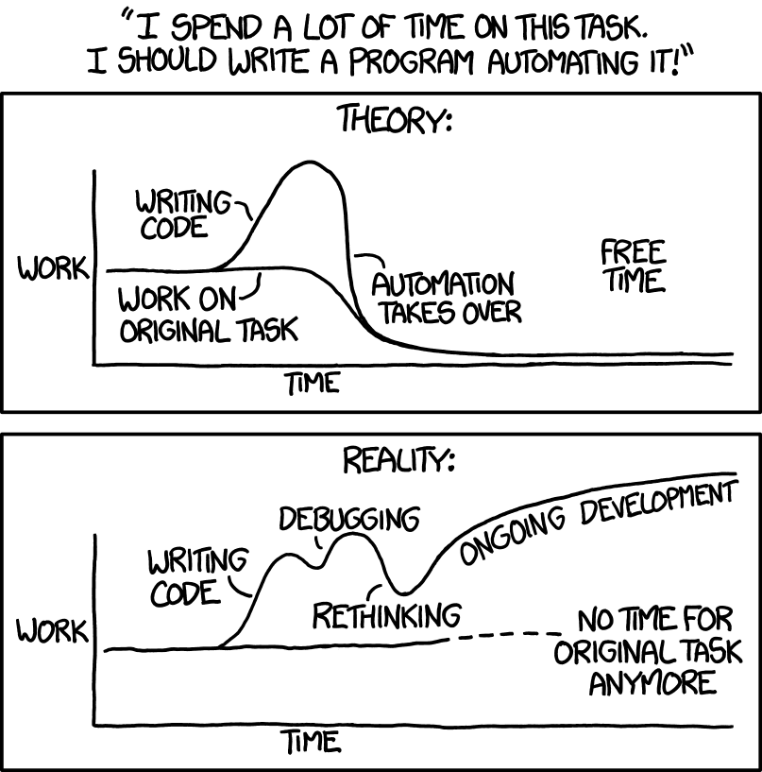
Automatic Job Division - Shortcomings
Source: https://xkcd.com/1319/

Slide 16
#3: Share Resources - Requirements
Minimal account management
No job division
HTCondor only!
No resource contribution requirements

Slide 17
The OSG Model
OSG Submit and CM
OSG
Cluster

Slide 18


The OSG Model
OSG Submit and CM
OSG
Cluster

Slide 19
The OSG Model
Pilot Jobs
OSG Submit and CM
OSG
Cluster

Slide 20
The OSG Model
Pilot Jobs
OSG Submit and CM
OSG
Cluster

Slide 21




Job Matching
On a regular basis, the central manager reviews Job and Machine attributes and matches jobs to slots.
execute
submit
central manager
execute
execute

Slide 22
The OSG Model
OSG Submit and CM
OSG
Cluster

Slide 23

The OSG Model - Jobs in Jobs
Photo Credit: Shereen M, Untitled, Flickr https://www.flickr.com/photos/shereen84/2511071028/ (CC BY-NC-ND 2.0)

Slide 24
The OSG Model - Details
Pilot jobs (or pilots) are special jobs
Pilots are sent to clusters with idle resources
Pilot payload = HTCondor execute server software
Execute server reports to the Open Science pool
Pilots lease resources from OSG clusters:
Lease expires after a set amount of time or lack of demand
Leases can be revoked!
On average, the Open Science pool has 10k total cores and most users get 500+ cores at a time!

Slide 25
#3: Share Resources - Requirements
Minimal account management: only one submit server
No job division: only one HTCondor pool
HTCondor only: pilots report back as HTCondor slots, you’ll be using an HTCondor submit server
No resource contribution requirements: the OSG doesn’t require that users “pay into” the OSG. Approved researchers can use OSG for free!

Slide 26

The OSG Model - Collection of Pools
Your jobs will run in the Open Science pool (open to individual researchers and campuses)
The Open Science pool is one of many!
Separate pools for each Virtual Organization (VO)
Photo by Martin Sanchez on Unsplash

Slide 27
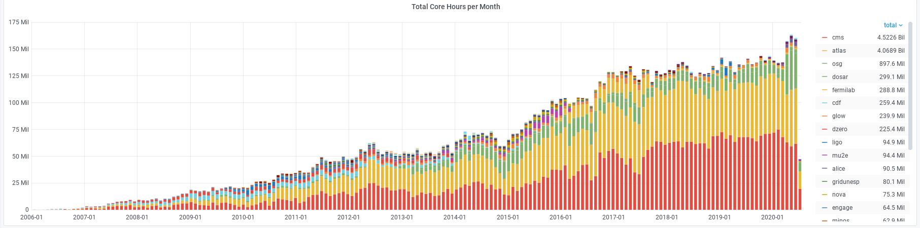
The OSG Model - Collection of Pools
Photo by Martin Sanchez on Unsplash

Slide 28

Pilot jobs are awesome!
Photo by Zachary Nelson on Unsplash

Slide 29
What’s the Catch?
dHTC requires complex machinery but OSG manages the hard bits so you don’t have to!

Slide 30
#1: Heterogenous Resources
Accounting for differences between the OSG and your local cluster

Slide 31
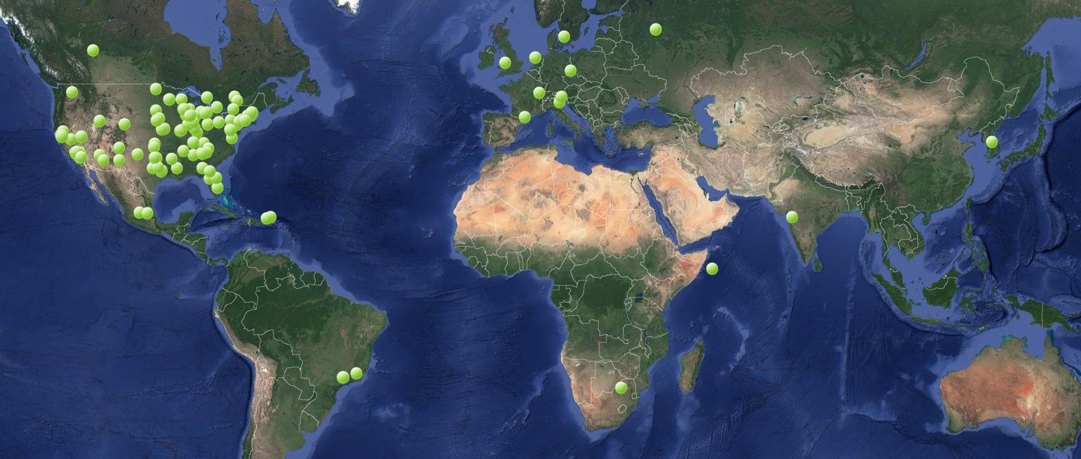
Clusters of the OSG
Source: http://display.opensciencegrid.org/

Slide 32
Het. Resources - Software
Different variants of Linux (Red Hat based)
Varying software versions (e.g., at least Python 2.6)
Varying software availability (e.g., no BLAST*)
Solution: Make your jobs more portable (more in tomorrow’s talk and exercises)

Slide 33
Het. Resources - Hardware
CPU: Mostly single core
RAM: Mostly < 8GB
GPU: Limited #s but more being added
Disk: No shared file system (more next Tuesday)
Solution: Where possible, split up your workflow to make your jobs more high throughput!

Slide 34
#2: With Great Power Comes Great Responsibility
How to be a good netizen

Slide 35

Resources You Don’t Own
Primary resource owners can kick you off for any reason (generally if your job is using too many resources)
No local relationships
No sensitive data!
Photo by Nathan Dumlao on Unsplash

Slide 36
Be a Good Netizen!
Use of shared resources is a privilege
Only use the resources that you request
Be nice to your submit servers
Solution: Test jobs on local resources with condor_submit -i (covered in tomorrow’s exercises)

Slide 37
#3: Slower Ramp Up
Leasing resources takes time!

Slide 38
Slower Ramp Up
Adding slots: pilot process in the OSG vs slots already in your local pool
Not a lot of time (~minutes) compared to most job runtimes (~hours)
Small trade-off for increased availability
Tip: If your jobs only run for < 10min each, consider combining them so each job runs for at least 30min

Slide 39
Job Robustification
Test small, test often
Specify output, error, and log files at least while you develop your workflow
In your own code:
Storing intermediate results (i.e., self checkpointing)
Defensive troubleshooting (hostname, ls -l, pwd, condor_version in your wrapper script)
Add simple logging (e.g. print, echo, etc). Be strategic and don’t fill your disk with logs!

Slide 40
#4: dHTC Security
The internet can be a scary place!

Slide 41
dHTC Security
OSG does its best but security is a game of risk mitigation, not perfection
OSG uses secure technologies to verify the identities of distributed servers
OSG Security Team tracks software vulnerabilities and responds to security incidents
Not just any old cluster or user can join the OSG! VOs approve users, cluster owners verify servers, and OSG verifies clusters
But there are thousands of servers and users!

Slide 42
So What Can You Do?
You are using a shared computer that you don’t own so take basic precautions!
Protect your data:
No files that can be overwritten by other users (i.e., not world writable)
No private data or software
Protect your account
Do not share your account
Use good passwords (and a password manager)
Use SSH keys wherever possible

Slide 43
Questions?
Coming next:
Grid exercises: https://opensciencegrid.org/virtual-school-pilot-2020/#materials/#grid
New submit host: login04.osgconnect.net
Set a default project for your login04 account: $ connect project
Tomorrow: Working with real software
Bonus topic next Wednesday: more grid!

